Slide 1
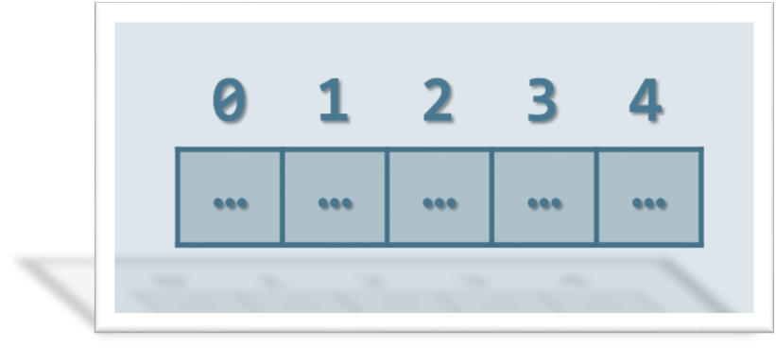
Arrays and Matrices
Arrays, Array Operations, Matrices, Multi-Dimensional Arrays
SoftUni Team
Technical Trainers
Software University
http://softuni.bg

Slide 2
Table of Content
Arrays
Definition
Accessing elements
Properties and Methods
Matrices
Definition
Loop through matrix
Manipulate data

Slide 3
Have a Question?
sli.do
#JS-CORE

Slide 4
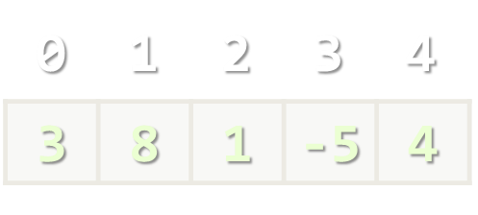
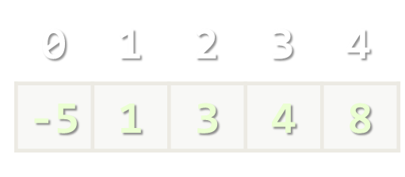
Arrays in JS
Working with Arrays of Elements

Slide 5

What is an Array?
JS arrays are used to store multiple values in a single variable.
Elements are numbered from 0 to length-1.
Creating an array using an array literal.
Creating an array using the keyword new.
Element index
Array of 5 elements
… | … | … | … | …
Array element
The better way.
let numbers = [10, 20, 30, 40, 50];
May create some unexpected results.
let numbers = new Array(10, 20, 30, 40, 50);

Slide 6
Arrays of Different Types
// Array holding numbers
let numbers = [10, 20, 30, 40, 50];
// Array holding strings
let weekDays = ['Monday', 'Tuesday', 'Wednesday',
'Thursday', 'Friday', 'Saturday', 'Sunday'];
// Array holding mixed data
var mixedArr =
[20, new Date(), 'hello', {x:5, y:8}];

Slide 7
Accessing Elements
Array elements are accessed using their index number.
Accessing indexes that do not exist in the array returns undefined.
let cars = ['BMW', 'Audi', 'Opel'];
let firstCar = cars[0]; // BMW
let lastCar = cars[arr.length - 1]; // Opel
console.log(cars[3]); // undefined
console.log(cars[-1]); // undefined

Slide 8
Problem: Sum First Last
You are given an array of string elements.
Multiplicate each element with the length of the array and print each index with its value.
function sumFirstLast(numArr) {
let listInput = JSON.parse(document.getElementById("arr").value);
let divResult = document.getElementById('result');
function calculate(list) {
for (let i = 0; i < list.length; i++) {
let p = document.createElement('p');
p.textContent = `${i} -> ${list[i]*list.length}`
divResult.appendChild(p) }
}
calculate(listInput);
}
Check your solution here: https://judge.softuni.bg/Contests/Practice/Index/1464#0

Slide 9
Changing elements
Elements can be modified.
JS arrays are resizable.
Note that adding elements with high indexes can create undefined "holes" in an array!
let fruits = ['Apple', 'Kiwi'];
fruits[0] = 'Peach';
console.log(fruits); // ['Peach', 'Kiwi']
fruits.push('Banana');
fruits[fruits.length] = 'Mango';
// both examples add a new element to the array

Slide 10
Problem: Even Position Element
You are given an array of numbers.
Find the elements at even position and print them.
function solve(numArr) {
let listInput = JSON.parse(document.getElementById("arr").value);
let result = [];
function calculate(numArr) {
numArr.forEach((element, index) => {
if (index % 2 === 0) {
result.push(element);
}
});
}
calculate(listInput);
document.getElementById("result").innerHTML = result.join(' x ');
}
Check your solution here: https://judge.softuni.bg/Contests/Practice/Index/1464#1

Slide 11
Properties and Methods
The length property returns the number of elements.
The sort() method sorts the item of an array. By default, it sorts the values as strings in alphabetical and ascending order.
However, if numbers are sorted as strings, "25" is bigger than "100", because "2" is bigger than "1".
let fruits = ['Mango', ‘Kiwi', 'Orange'];
console.log(fruits.length); // returns 3
console.log(fruits.sort());
// ['Kiwi', 'Mango', 'Orange']

Slide 12
Sorting an array of numbers
let nums = [20, 40, 10, 30, 100, 5];
console.log(nums.join(' ')); // 20 40 10 30 100 5
nums.sort(); // Works incorrectly on arrays of numbers
console.log(nums.join('|')); // 10 100 20 30 40 5
Sorting numbers in ascending order
Sorting numbers in descending order
nums.sort((a, b) => a - b); // Compare elements as numbers
console.log(nums.join(' ')); // 5 10 20 30 40 100
nums.sort((a, b) => b - a); // Compare elements as numbers
console.log(nums.join(' ')); // 100 40 30 20 10 5

Slide 13
Add / Remove Elements at Both Ends
let nums = [10, 20, 30];
console.log(nums.join('|')); // 10|20|30
nums.push(40);
console.log(nums.join('|')); // 10|20|30|40
let tail = nums.pop(); // tail = 40
console.log(nums.join('|')); // 10|20|30
nums.unshift(0);
console.log(nums.join('|')); // 0|10|20|30
let head = nums.shift(); // head = 0
console.log(nums.join('|')); // 10|20|30

Slide 14
Problem: Replace and Reverse
You are given an array of strings.
Make the first letter of each element upper and reverse the array.
function solve(numArr) {
let listInput = JSON.parse(document.getElementById("arr").value);
function calculate(numArr) {
numArr.forEach((element, index) => {
numArr[index] = element.split('').reverse().join('');
});
numArr.forEach((element, index) => {
numArr[index] = element.charAt(0).toUpperCase().concat(element.slice(1));
});
return numArr.join(' ');
}
let result = calculate(listInput);
document.getElementById("result").innerHTML = result;
}
Check your solution here: https://judge.softuni.bg/Contests/Practice/Index/1464#2

Slide 15
Slicing Arrays
let nums = ['one', 'two', 'three', 'four'];
console.log(nums.join('|')); // one|two|three|four
let firstNums = nums.slice(0, 2); // start, end+1
console.log(firstNums.join('|')); // one|two
let lastNums = nums.slice(2, 4); // start, end+1
console.log(lastNums.join('|')); // three|four
let midNums = nums.slice(1, 3); // start, end+1
console.log(midNums.join('|')); // two|three

Slide 16
Splice: Cut and Insert Array Elements
let nums = [5, 10, 15, 20, 25, 30];
console.log(nums.join('|')); // 5|10|15|20|25|30
let mid = nums.splice(2, 3); // start, delete-count
console.log(mid.join('|')); // 15|20|25
console.log(nums.join('|')); // 5|10|30
nums = [5, 10, 15, 20, 25, 30];
nums.splice(3, 2, "twenty", "twenty-five");
console.log(nums.join('|'));
// 5|10|15|twenty|twenty-five|30

Slide 17
Looping through an array
for … of works like foreach
for … in goes through array indices
Traditional for-loop
let nums = [5, 10, 15, 20, 25, 30];
for (let num of nums)
console.log(num);
for (let i in nums)
console.log(i + " " + nums[i]);
for (let i = 0; i < nums.length; i++)
console.log(nums[i]);

Slide 18
Problem: Find Element
You are given a string and an array of strings.
Search if the string is present in each element of the array.
function solve() {
let number = parseInt(document.getElementById("num").value);
let listInput = JSON.parse(document.getElementById("arr").value);
let answer = [];
function calc(searched, input) {
for (let element of input) {
let result = element.includes(searched);
let index = element.indexOf(searched);
answer.push(result + ' -> ' + index);
}
return answer;
}
let result = calc(number, listInput);
document.getElementById("result").innerHTML = result;
}
Check your solution here: https://judge.softuni.bg/Contests/Practice/Index/1464#3

Slide 19
More Array Methods
includes() – check if an array contains a specific element
indexOf() - returns the position of an element in an array
isArray() – checks if an object is an array
reverse() – reverses the order of elements in an array
toString() – converts an array to string
reduce() – reduces the values of an array (from left to right)
Note that you CANNOT reduce an empty array!

Slide 20
Problem: Multiple Sort
You are given an array of strings. Sort the elements by ascending order and then alphabetically.
function solve() {
let listInput = JSON.parse(document.getElementById("arr").value);
let sortAscending = [];
let sortAlphabetically = [];
function calc(input) {
let resultContainer = document.getElementById("result");
let div1 = document.createElement('div');
let div2 = document.createElement('div');
sortAscending = input.sort((a, b) => a - b); div1.textContent = sortAscending.join(', ')
resultContainer.appendChild(div1);
sortAlphabetically = input.sort((a, b) => a.localeCompare(b)); div2.textContent = sortAscending.join(', ')
resultContainer.appendChild(div2);
}
calc(listInput);
}
Check your solution here: https://judge.softuni.bg/Contests/Practice/Index/1464#4

Slide 21
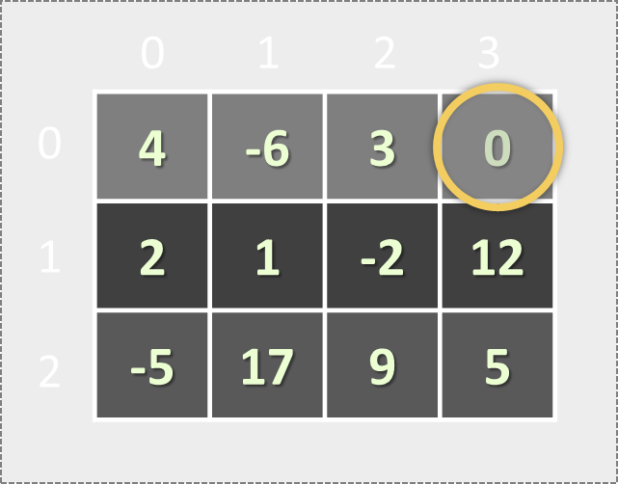
Matrices
Array of Arrays

Slide 22
Matrices in JS
A matrix is a table of values.
Matrices are represented as nested arrays in JavaScript.
0 1 2 3
let matrix = [
[4, -6, 3, 0],
[2, 1, -2],
[-5, 17],
[7, 3, -9, 12]
];
4 | -6 | 3 | 0
Matrix of 4 rows
0
1
2
3
2 | 1 | -2
-5 | 17
Element matrix[2][0] at row 2, column 0
7 | 3 | -9 | 12

Slide 23
Looping through a matrix
let matrix = [[4, 5, 6],
[6, 5, 4],
[5, 5, 5]];
for (let row = 0; row < matrix.length; row++) {
console.log(matrix[row]); // [4, 5, 6]
// [6, 5, 4]
// [5, 5, 5]
for (let col = 0; col < matrix[row].length; col++) {
console.log(matrix[row][col]);
// prints each element of the matrix on a separate line
}
}

Slide 24

Live Exercises

Slide 25

Summary
…
…
…
Arrays are used to store multiple values in a single variable.
Elements are accessed using their index number.
Sorting and modifying elements using methods.
Looping through arrays with for … of, for … in and traditional for-loop.
A matrix is a table of values.

Slide 26
https://softuni.bg/courses/javascript-fundamentals

Slide 27












SoftUni Diamond Partners

Slide 28




SoftUni Organizational Partners

Slide 29




Trainings @ Software University (SoftUni)
Software University – High-Quality Education and Employment Opportunities
softuni.bg
Software University Foundation
http://softuni.foundation/
Software University @ Facebook
facebook.com/SoftwareUniversity
Software University Forums
forum.softuni.bg

Slide 30

License
This course (slides, examples, demos, videos, homework, etc.) is licensed under the "Creative Commons Attribution-NonCommercial-ShareAlike 4.0 International" license

